Slide 1
Respiratory Protection & Silica Awareness
OSHA 29CFR 1926.103 (1910.134)

Slide 2
HOW TO REDUCE YOUR RISK
ENGINEERING CONTROLS
Physically Moving the Hazard
Enclose the Hazard so it’s Not exposed
Establish Barriers/Ventilate to Minimize Exposure
ADMINISTRATIVE CONTROLS
Necessary Precautions
Site Specific Work Plans

Slide 3
Why do People Continue to Make Choices Proven to Severely Injury & Kill Themselves?

Slide 4
3 Most Common Reasons for Bad Choices
PERCEPTIONS
HABITS
BARRIERS

Slide 5
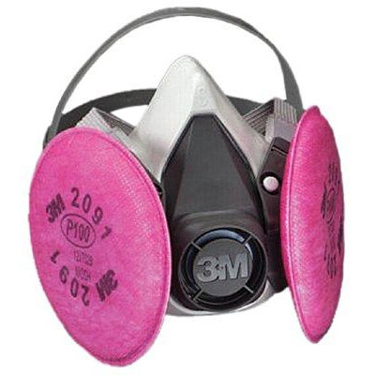
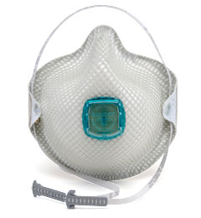
WHY ARE WE HERE TODAY?
Respiratory Protection &
Silica Standard Awareness…..

Slide 6
ENGAGEMENT OF THE PLAN DOES NOT REQUIRE ENFORCEMENT OF THE PLAN…….

Slide 7
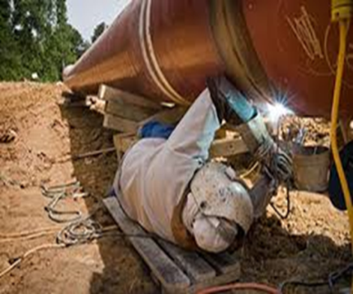
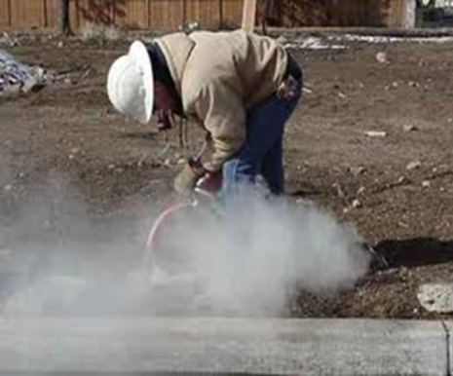
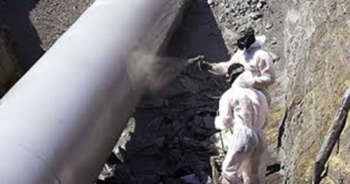
THE STUFF WE DEAL WITH OUT THERE
DUSTS
Grinding
Crushing
Sanding
Sawing
MISTS/VAPORS
Spraying
Cleaning
Solvents
Volatile Compounds
FUMES
Molten Metal
Welding
Laser Cutting
GASES
Oxygen
Carbon Dioxide
Carbon Monoxide
Hydrogen Sulfide

Slide 8
N100 USE
MANDATORY MINIMUM USE IF DRY CUTTING, DRILLING WITH CONRETE
VOLUNTARY USE FORM APPENDIX D
DO NOT USE WHEN WORKING WITH GASES, VAPORS, ASBESTOS, OR WHEN PARTICULATES EXCEED 10X OSHA PEL (Permissible Exposure Limits)
Assigned Protection Factor (APF10)
DO NOT USE IN IDLH ATMOSPHERES OR OXYGEN DEFICIENT AREAS

Slide 9
Mandatory Employee Information: Voluntary Use
Appendix D – 29 CFR 1910.134
Please Read This Document
Any Questions??

Slide 10
FACIAL HAIR
Employees must be clean shaven in order to have respirators properly fitted for use.

Slide 11
AUTHORIZED USE ONLY!
If you have to ask if you are qualified to wear, you probably aren’t qualified to wear a respirator.
DO NOT BRING YOUR OWN RESPIRTATORS

Slide 12
Standard Respiratory Program
Online Medical Exam
3M Questionnaire
Determines Eligibility Based on Health Inquiry
Follow-up Physical with Medical Dr. may be Necessary
PowerPoint Presentation
Review of PSC Standards
OSHA Requirement
Respirator Fit Test
Bitrex “Smoke” Test

Slide 13
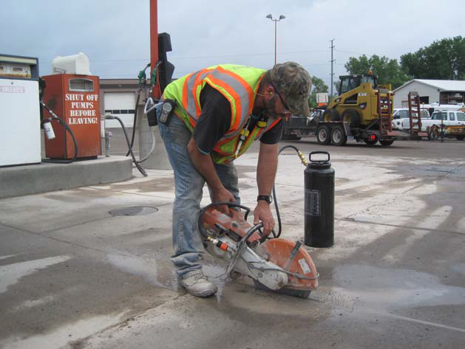
Silica Awareness Standard
Based on the personal air monitoring results as well as observations that were made during the collection of the above exposure assessment-based data, following are reasonable conclusions that can be made:
The testing results indicate that the employee’s calculated 8-hour exposure to quartz silica for these cutting scenarios would not have exceeded 1/10th of the calculated quartz silica exposure limit.
The testing results indicate that the dry-cutting of asphalt emitted concentrations of quartz silica that are nearly twice than the dry-cutting of concrete.
The testing results indicate that the wet-cutting systems for both the Stihl and Norton pavement cutting devices were effective at minimizing the emission of airborne pavement-based particulates.
The moderate amount of dust that is emitted during the dry cutting of concrete and asphalt creates a potential for other employees in the immediate work area to be exposed to such airborne particulates.

Slide 14
Concrete or Asphalt Cutting Recommendations
Whenever possible, the wet-cutting method should be utilized for both the hand-held Stihl and push-style Norton pavement cutting systems.
All employees should be instructed of their need to take the necessary precautions to position the hand-held and the push-style pavement cutting saws in a manner which minimizes their exposure to airborne particulates that are generated during dry cutting activities. Based on observations that were made during this monitoring, this would involve pointing the saw into the wind for the Stihl hand-held saw and traveling with the wind with the Norton push-style saw.
The use of approved negative-type respiratory protection during the dry cutting of concrete asphalt would be acceptable provided that additional forms of particulate exposure are not present during the remainder of the employee’s work shift.
In order to maximize the protection that worn respirators provide, it is recommended that all employees who are required to wear approved respiratory protection also be required to be clean shaven at the beginning of each work-day.

Slide 15
OSHA Silica Standard 1926.1153
For ALL WET OPERATIONS OUTSIDE UNDER 4 Hours, NO MASK REQUIRED.
Walk-Behind Saws: As long as use is OUTDOORS and WET METHODS performed: NO MASK REQUIRED <>4Hrs
Focuses on:
a < or > 4 hour threshold
Indoor/Outdoor
Wet or Dry Operations
Hand-Held Saws: When Used OUTDOORS & WET METHODS performed: < 4hrs NO MASK; >4hrs N100
Jackhammer/Chippers: When used OUTDOORS & WET METHODS performed: < 4hrs NO MASK; >4hrs N100
Hand/Stand Drilling: When used OUTDOORS & when dust collection performed: NO MASK REQUIRED <>4Hrs
ANY DRY METHODS or INDOOR USE MUST USE N100

Slide 22
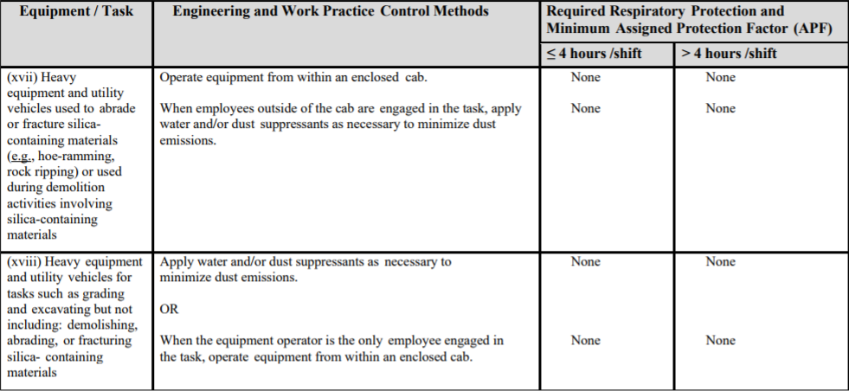

Slide 23
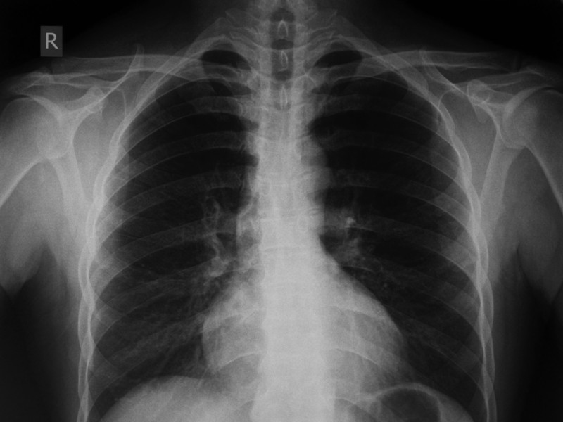
LUNG X-RAY
This is a picture of a healthy lung x-ray. Note the clarity of the lung areas. There appear to be no defects, marks or abnormalities here. This is what we want to see on our x-rays.

Slide 24
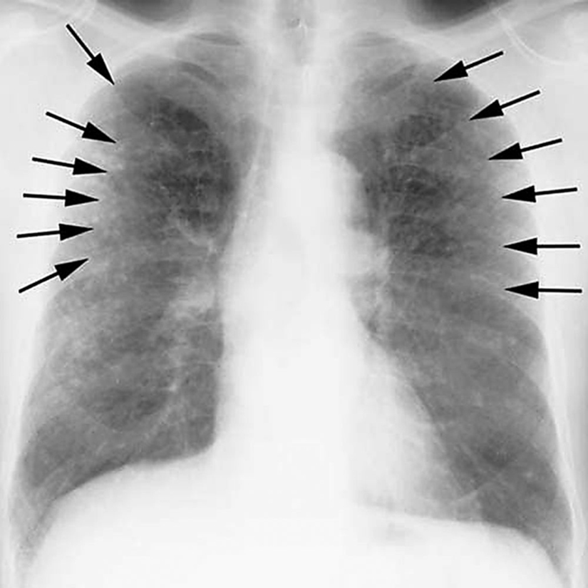
SILICOSIS
Shortness of breath exacerbated by exertion
Cough, often persistent, sometimes severe
Fatigue
Tachypnea (rapid breathing), often labored
Loss of appetite and weight loss
Chest pain
Fever
Gradual dark shallow rifts in nails eventually leading to cracks as protein fibers within nail beds are destroyed.
In advanced cases, the following may also occur:
Cyanosis (blue skin)
Cor pulmonale (right ventricle heart disease)
Respiratory insufficiency

